Slide 1
Decision Making and Budgeting in the EU: The Game of Thrones in European Governance
Dimitrios V. Skiadas, MJur, PhD
Professor of European Governance
Dept. of International and European Studies
University of Macedonia

Slide 2
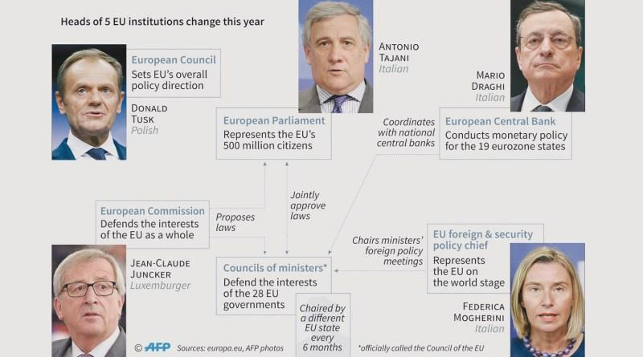
EU - Game of Thrones

Slide 3
In the EU the “Game of Thrones” is two-fold:
Political in the sense that “political groups” (even encompassing states) “political families” and “political parties” at EU level compete against each other in order to obtain political leadership in the EU
Institutional in the sense that the Institutions of the European Union compete against each other in their effort to dominate over the system of power and authority that the Union entails.
This “Game” of political and institutional competition is reflected most clearly in the decision making and budgetary procedures of the EU.

Slide 4
The Historical context
“A page of history is worth a volume of logic” [Justice Oliver Wendell Holmes Jr in New York Trust Co. et. al. v Eisner (1921) 256 U.S. 345 at 349]
Since the beginning, the European Experiment has been based on two concepts, on two types of action and on two orientations
Concepts
Deepening: Progressive increase of the authority (scope and contents of powers) conferred to the European Institutions, exclusively or shared with the national authorities of the Member States
Enlargement: Progressive increase of the number of countries entering the process (initially the European Communities and subsequently the European Union)
Types
Integration: Delegation of sovereignty to a supranational legal system integrated with the national legal system of the Member States
Intergovernmental Cooperation: Long term and formalized commitment of the Member States to work collaboratively in certain areas for the protection and promotion of their common interests.
Orientations
Federalism: To build a federal (economic & political) Europe based on a full project
Functionalism: To build a supranational institutional order through gradual integration, area by area, starting from market unification

Slide 5
The first institutional scheme - European Coal & Steel Community(1952):
High Authority (experts appointed by member states with strong autonomy in decision making)
Council of Ministers (representatives of nation-states)
Assembly (representatives of national parliaments)
Court of Justice (judicial body to settle disputes)
Advisory Committee (representatives of social partners)
Further institutional development – European Economic Community and European Atomic Energy Community (1957):
Similar institutional outlook for the Communities(Commission instead of Authority)
New policy areas to be addressed - Customs Union (elimination of customs duties and quantitative restrictions on internal trade, external common customs tariff), Free movement of goods persons, services and capital, Competition, Common Policies in agriculture, transport, trade, etc.
Convention (1957) and Merger Treaty (1965) establishing single institutions for all three Communities.
The first clash occurred in the 1960s between proponents and opponents of supranationalism, especially due to the French opposition to strengthening the powers of the Communities, adopting qualified majority decision-making procedures and Britain entering the Communities. This lead to the so-called empty chair crisis (1967) and was solved with the Luxembourg compromise, which prevented from any changes taking place at that time.

Slide 6
In the 1970s significant institutional developments took place:
The first enlargement took place, encompassing United Kingdom, Ireland and Denmark.
The 1970 change of the system of financing of the Communities which were equipped with their own resources through
a) agricultural levies (already foreseen since 1962) which consisted of taxes charged in respect of trade in agricultural products with non-member states within the framework of the common agricultural policy, as well as contributions to the production and storage of sugar and isoglucose
b) customs duties which were levied at the external borders of the Communities on imports (according to the Customs Union) and
c) a resource based on value added tax (VAT) which was a transfer of a percentage of the national VAT, obtained by applying a given rate to a VAT base determined in a uniform manner for the Member States on the basis of Community rules.
Also, the Communities could use, as resources, deductions from Community staff salaries, wages and allowances, interest on late payments and fines, various taxes, revenue from the sale of publications, etc.
This system has been always treated as falling within the purvue of the Council.
In 1975 the authority of the Parliament over budgeting was increased and the Court of Auditors was established (replacing the weak Audit Board), while the 1976 Act providing for the direct election of Parliament, without increasing further its powers.
The first direct elections for the European Parliament took place in 1979.

Slide 7
The 1980s context entailed a strong pro-European movement by several states and international actors, especially with regard to achieving completion and deepening of the Single Market, while, at the same time, the great integration of markets was to be counterbalanced by the further development of other policies aimed at achieving a greater social and territorial cohesion.
The second enlargement took place, encompassing Greece (1981), Spain and Portugal (1986), which led to an increase in regional disparities inside the Communities and caused greater urgency in launching the reformed regional policy in 1988.
The Single European Act (1987) provided for new policies (ie completion of single market by 1992 through the elimination of physical fiscal and technical barriers of free movement, the economic and social cohesion policy, the policy for research and development, the environmental policy, the social policy, etc) and for institutional reforms by mentioning the European Council (albeit not as institution of the Communities), introducing qualified majority voting in the Council as a decision making method for some matters, strengthening the legislative power of Parliament by introducing the cooperation procedure and the assent procedure (Parliament no longer has advisory powers only), setting up the Court of First Instance in support of ECJ and and institutionalizing European political cooperation in foreign policy.
In 1988 a fourth own resource was introduced, based on the application of a rate to the gross national product (GNP) of the Member States: the GNP resource.
The break up of the USSR, the fall of the Berlin Wall (1989) and the German reunification (1990) provided an impetus for speeding up efforts for European monetary social and political integration.

Slide 8
Thus, in the 1990s, the main elements of the European experiment were enriched with new concepts:
From single market to single currency
From economic to social integration (Social Protocol, European citizenship rights, other areas of non-economic jurisdiction)
From economic to political integration (Justice and Foreign Policy)
From the Economic Community to the European Union
All these changes were institutionalized in the European Union Treaty (1992).
The European Union entailed a three-pillar structure:
First Pillar: the European Communities (ECSC, EEC and Euratom)
Second pillar: common foreign and security policy (CFSP)
Third Pillar: Justice and Home Affairs (JHA)
The first pillar worked on community method, while the second and third on intergovernmental cooperation.
In terms of institutional changes the Economic and Monetary Union was established with the European System of Central Banks and the European Central Bank (1998), the European citizenship and the Principle of subsidiarity were introduced, the power of Parliament was increased further with the introduction of co-decision procedure in some areas, the European Council became an institution of the European Union and the European Ombudsman was established.

Slide 9
Following the 1992 Treaty, the Union embarked in a very challenging endeavour to further consolidate its course:
In 1993 it set out the Copenhagen Criteria for candidate countries regarding rule of law, democracy, human rights, respect for minorities, market economy, rules of competition and competitiveness, acceptance of the acquis communautaire
A new enlargement took place encompassing Sweden, Finland and Austria (1995), however there were negative referenda in Switzerland and Norway.
An eastward expansion was decided, which set a series of challenges at political level (most candidates were countries in transition to democracy), economic level (most candidates were countries in transition to market economies and countries with a very low per capita income) and institutional level (the increased size of the acquis Communautaire would impede the candidates’ perspectives).
The Amsterdam Treaty (1997) set some new policies (introduction of EU basic principles: freedom, democracy, respect for human rights, rule of law, enriched employment and social policies were set, issues relating to migration, asylum etc were moved to the Union’s first pillar, the Schengen agreement was incorporated into the EU third pillar, etc) and introduced significant institutional modifications, such as the increase of the use of qualified majority, the adoption of the Codecision procedure becomes as standard procedure, the approval of the Commission President by the Parliament, the formalization and regulation of enhanced cooperation in the first and third pillars, the establishment of the High Representative for Foreign Policy, the redifinition of CFSP instruments (Common strategies are the responsibility of the European Council and required unanimity while “Joint actions” and “common positions” are the responsibility of the Council and required qualified majority) and the definition of EU military actions.

Slide 10
The eastward enlargement which was to take place in the 2000s necessitated the revision of the Union’s decision-making structure and procedure.
Thus the Treaty of Nice (2001) introduced large scale changes by providing a transitional increase of the number of Commissioners to be later reduced to 14 by fair rotation, a new weighting of states’ votes in the Council, the strengthening of the powers of the President of the Commission, elected by qualified majority, a new method of reaching a qualified majority in Council with the adoption of a criterion that takes into account the votes, the number of states and, on request, inhabitants, a further enlargement of the scope of application of qualified majority voting, the expansion of the scope of the co-decision process, the increase of the Parliament's membership and the introduction as a political declaration of the EU Charter of Fundamental Rights.
The subsequent effort to further redesign the Union though the introduction and adoption of a Constitutional Treaty, seen as a step further to the federalist direction, failed.
Thus a new Treaty, the Lisbon Treaty was adopted (in force 2009), in an effort to provide a comprehensive institutional system for the Union’s operations (preparation and implementation of policies falling within its competences).

Slide 11
This brief historical account demonstrates the “drivers” behind the constant evolution and changes in the EU institutional architecture
The burden of interest:
the interest of nation states (negotiating stance)
the intent to maintain control of decision-making (not to delegate national sovereignty)
The role of institutions
the strength of rules (the rules affect the processes)
the autonomy of European institutions (institutions pursue their own interests)
The power of ideas
The weight of ideologies: federalism and functionalism
Effects of culture and national traditions
The external context
The international environment within which the Union is being developed.

Slide 12
The current context
The agenda setting for activity in the EU context has been formulated into three clearly divided categories of competencies/jurisdiction between the EU and its member states:
Exclusive jurisdiction of the EU: customs union, competition rules, monetary policy European countries, marine biological resources, trade policy union
Shared powers between the EU and its Member States: internal market, some social policies, cohesion, agriculture, fisheries, environment, consumer protection, transport, trans-European networks, energy, space of freedom, security and justice, public health, research
Expertise to support, coordinate or supplement the actions of the States: health, industry, culture, tourism, education, youth, sports, vocational training, civil protection, administrative cooperation.
In the case of non-exclusive competences, the principle of subsidiarity regulates the right of initiative and the extent of action of each actor: the EU takes action only if and insofar as the objectives of the proposed action can not be sufficiently achieved by Member States, and can therefore, by reason of the scale or effects of the proposed action be better achieved at EU level.

Slide 13
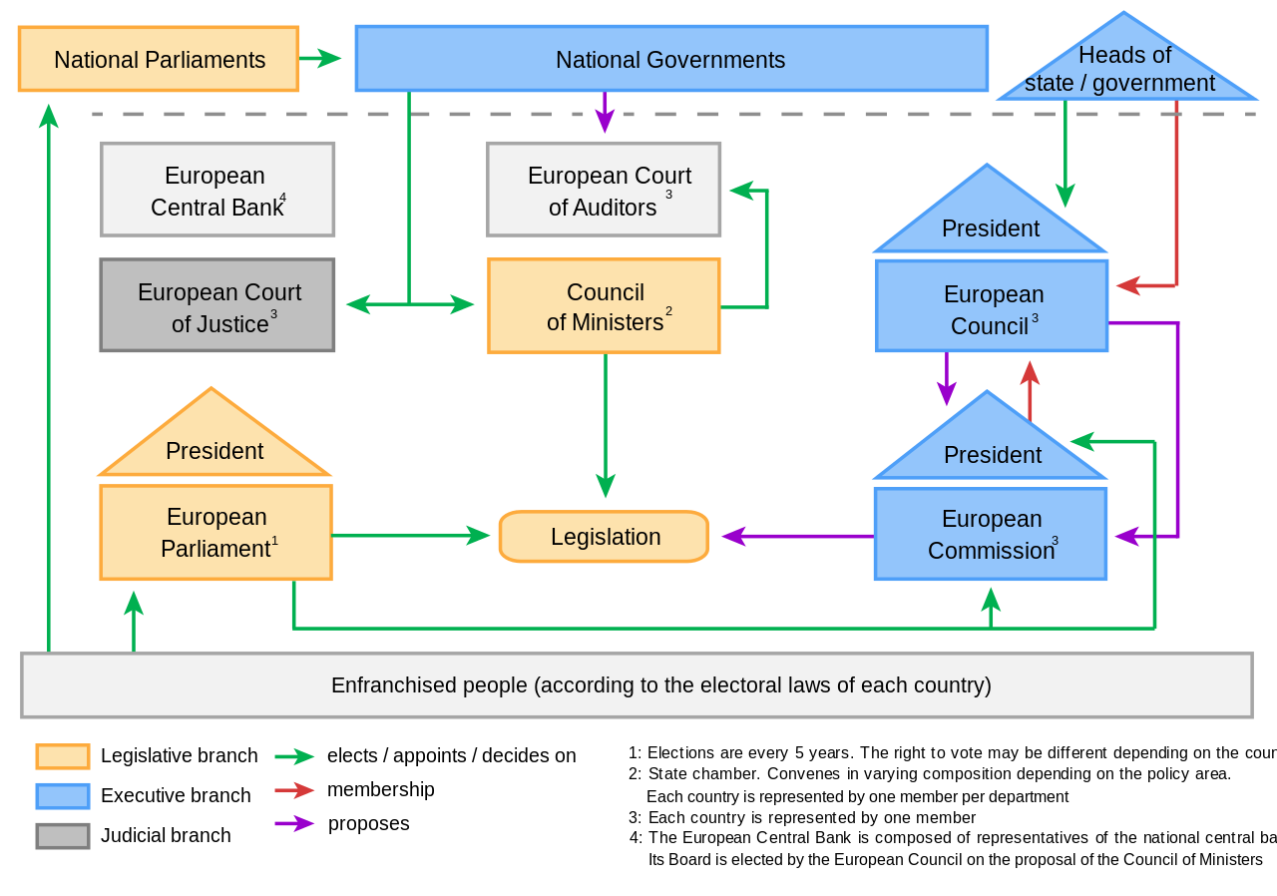
The current… “7 Kingdoms” of the EU

Slide 15
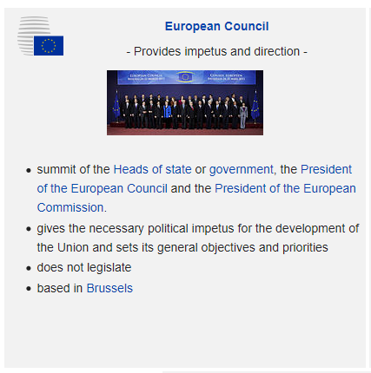
The European Council is a decision-making body in the political rather than technical sense:
it does not vote on the measures but acts on the basis of "consensus"
Provides the impetus for development of EU and defines general political guidelines through the Conclusions (meets at least twice a year)
It has jurisdiction on questions of European integration and on those of cooperation between states (e.g. foreign policy)
Resolves disputes on most controversial European dossiers
Its President is elected for 2 ½ years by a qualified majority and is eligible for re-election only once

Slide 16
The Council is the main decision making body. Chaired by each Member State with a six-monthly rotation. Exercises six key responsibilities:
Adopts legislation, together with Parliament, in many sectors
Coordinates the economic policies of MS
Concludes international agreements between the EU and other countries or international organizations
Approves the EU budget together with the European Parliament
Develops Common Foreign and Security Policy (CFSP), based on guidelines set by the European Council
Coordinates cooperation between the courts and national police forces on crime
It acts by qualified majority, except in some particularly sensitive areas(eg taxation, CFSP or policies on asylum and immigration) for which unanimity is required

Slide 18
The European Parliament has 751 members. It exercises 3 main functions:
It shares legislative power with the Council in many policy areas, through the consultation, co-decision or assent procedures. Can ask Commission to present legislative proposals
It exercises democratic supervision over other EU institutions and in particular the Commission, by approving or rejecting the nomination of Commissioners, by censuring the Commission as a whole, by reviewing the reports of the Commission, by questioning both the Commission and Council, by setting up committees of inquiry
It shares with the Council the power on the budget and can influence EU spending. At the end of the procedure it can either approve or reject the budget
MEPs aggregate into politically homogeneous groups, not by nationality
The European Parliament works through parliamentary committees

Slide 19
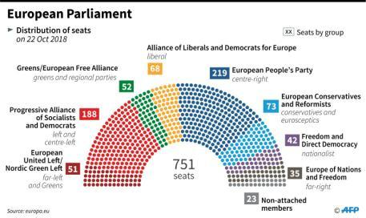
Methods of legislative action:
Consultation: the Council consults Parliament,
the EESC and the CoR. Parliament may approve the Commission’s proposal, reject it or ask for some changes (in this case, the Commission may accept and pass the amended proposal to the Council)
Assent: the Council must obtain consent of the European Parliament (acting by absolute majority) for decisions of particular importance. There is no possibility of amendment.
Codecision: main procedure used in the current
legislative process. Parliament shares legislative power equally with the Council. If case of no agreement on the proposed legislative text, it is submitted to a Conciliation Committee (Council and Parliament participate in equal numbers)

Slide 20
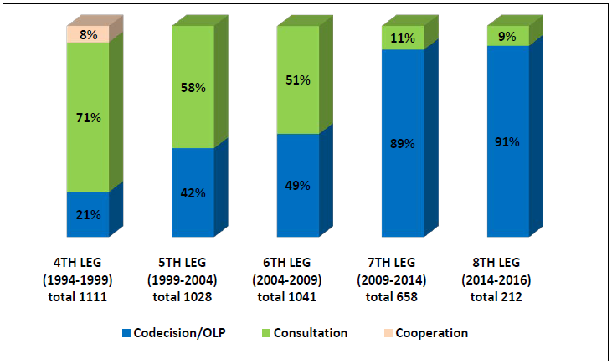
Gradual shift of the decision-making procedures in the EU

Slide 21
The European Commission is the Executive branch of the EU. It is independent of national Governments. Composed of one member from each national state. It has four main roles:
Proposes legislation to Parliament and the Council (exclusive “right of initiative”) in respect of the principle of subsidiarity
Manages and implements policies and manages the EU budget (but most of the spending is done by national or local authorities). Manages a set of common policies and community programs.
Oversees application of European law. Operates as a "guardian of the treaties" having the power to initiate infringement proceedings and to refer to the Court of Justice, which has power to impose fines
Represents the EU internationally as spokesperson and is responsible for negotiating international agreements on behalf of the EU

Slide 22
The Commission President is chosen by the European Council and approved by the Parliament
One Commission Vice-President is the High Representative for CFSP
The Commission has an administrative structure divided into directorates general and autonomous services

Slide 23
The Court of Justice ensures that EU legislation is interpreted and applied uniformly in and by all EU countries and EU institutions, it adjudicates disputes between Member States and EU institutions, businesses and private citizens. The procedures entail:
Preliminary rulings. In case of doubt on the interpretation or validity of a EU rule, a national court may, and sometimes must, ask the Court for an opinion
Failure to fulfil an obligation, A MS may be taken to the Court by the Commission or another MS for failing to act under EU law
Actions for annulment submitted by the MS, of legal acts adopted by the Parliament or the Council
Actions for failure to act in case of non-compliance with the obligations laid down by EU law by the Parliament, Council and Commission
Actions to establish liability: in an action for damage the Court rules on the liability of the EU for damage caused by its institutions or officials in the performance of their duties

Slide 24
The European Central Bank is independent of politics.
It manages the euro, it defines and implements economic policy and monetary policy.
It operates under the “European System of Central Banks” (ESCB), which includes all 28 EU countries.
It maintains price stability in the euro area (inflation under 2%).
Its administrative bodies: Executive Committee (President, Vice President and 4 others), Governing Council (representatives of central banks of Euro countries), General Council (representatives the central banks of all EU countries).
The president and the members of the Executive Committee are nominated by national governments.

Slide 25
The European Court of Auditors checks that EU funds are collected and verifies the legitimacy, relevance and proper purpose of expenditure.
It checks that the EU is implemented in accordance with the rules/principles of transparency, legality, regularity and sound financial management (economy, efficiency, effectiveness)
It has the right to audit any person or organization handling EU funds
It assists the European Parliament and the Council through the presentation of an annual report containing the financial audit of previous year and issues a declaration of assurance of the budget
It makes recommendations on proposed financial legislation in EU and on EU anti-fraud activities
MAIN OBJECTIVE: To ensure that taxpayers get maximum value for their money

Slide 26
Two Advisory Bodies:
European Economic and Social Committee: It represents employers, trade unions, farmers, consumers and other interest groups that collectively constitute the “civil society”. It has three fundamental tasks:
It formulates advice to the European Parliament, the Council or the Commission, either upon their request or on its own initiative;
It allows greater involvement and participation of civil society in EU policy making;
It strengthens the role of civil society in third countries and promote the establishment of structures based on same model
Committee of the Regions: It represents local and regional authorities of Europe. It must be consulted on matters of regional policy, environment, education and transport sectors and all of which concern local and regional governments. On its own initiative it may submit opinions to the Commission, the Council and the Parliament.

Slide 27
Means of legal action
EU law prevails over conflicting national law (Supremacy)
Regulation: binding in its entirety and directly applicable in all MS
Directive: binds MS to which it is addressed as regards the result to be achieved, leaving national authorities discretion as to the form and means of attaining it. It requires the receipt into national law, with the partial exception of self-enforcing directives
Decision: binding in its entirety for those, to which it is specifically addressed. In essence similar to national legal and administrative tool. Used by institutions to apply EU law in actual cases
Soft law (non-binding):
Recommendations
Opinions
Statements
Guidelines
Hard or binding law:
Regulations
Directives
Decision

Slide 28
Ordinary Legislative Procedure
It is the main operating scheme for the “Community method”. It has the following characteristics:
The Commission has the monopoly on legislative initiative .
Legislation must be approved by both European Council and Parliament, otherwise the act is not adopted.
The Council votes by qualified majority voting
Co-decision is the prevailing community method of making European legislation.
Note: In Common Foreign Security Policy, the community method is not applied.
Main actors: the European Council, the Council of Foreign Affairs, the High Representative for foreign and security policy.
Commission and European Parliament play a minor role
QMV is not adopted. Decisions on sensitive matters are taken unanimously
Decisions are not legislative in nature

Slide 29
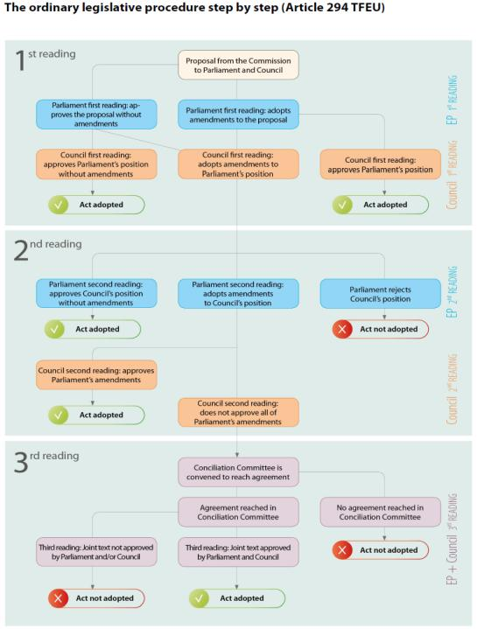

Slide 30
For an act to be adopted under the ordinary legislative procedure, the co-legislators must at some point during the procedure agree on a common text acceptable to both the Parliament and the Council.
This requires that the institutions talk to each other, which takes place in the form of trilogues: informal tripartite meetings on legislative proposals between representatives of the Parliament, Council and Commission. The trilogues are the institutional embodiment of the interaction between the institutional actors of the EU
Trilogues may be organised at any stage of the legislative procedure and can lead to what are known as 'first reading', 'early second reading' or 'second reading' agreements, or to a 'joint text' during conciliation.
Trilogues consist of political negotiations, although trilogues may be preceded by preparatory technical meetings (attended by the three institutions’ experts). During trilogue meetings, each institution explains its position and a discussion in view of finding a compromise develops.
The Commission acts as a mediator with a view to facilitating an agreement between the co-legislators.
The participants in trilogues operate on the basis of negotiating mandates given to them by their respective institutions. The three delegations explore possible avenues of compromise in an informal manner and report back or seek new instructions on a regular basis according to their respective institutions’ internal rules, i.e. via the negotiating team and/or in committee for Parliament, in Coreper or the responsible working party for Council.

Slide 31
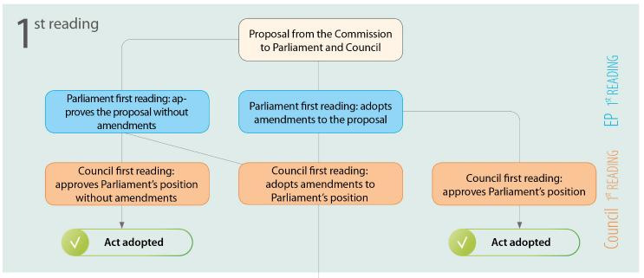
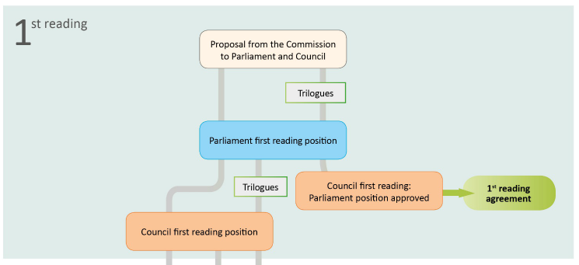

Slide 32
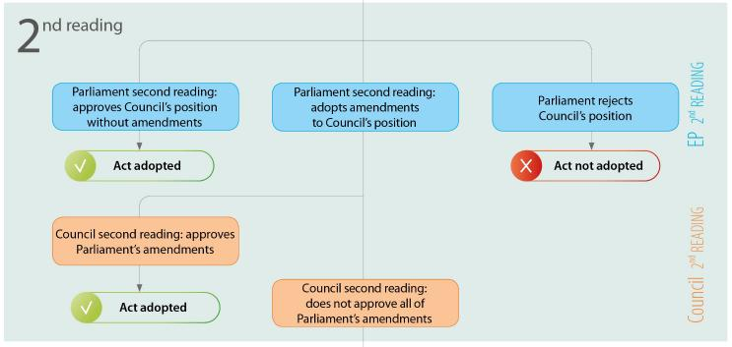
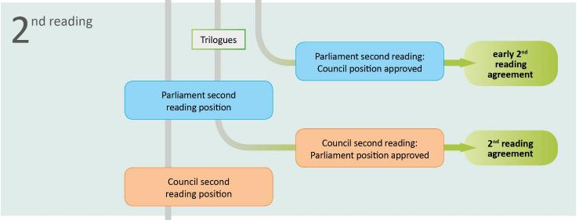

Slide 33
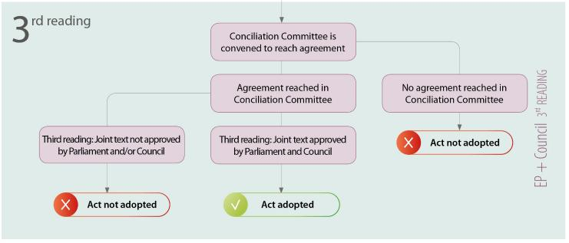
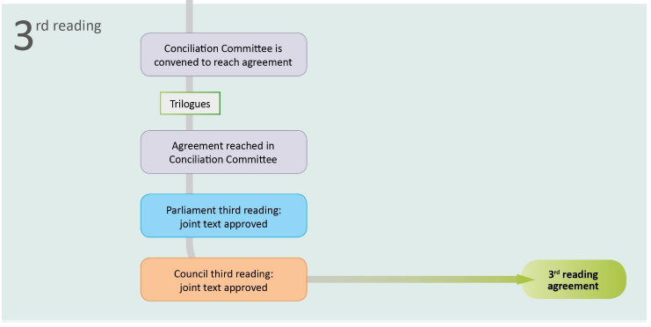

Slide 34
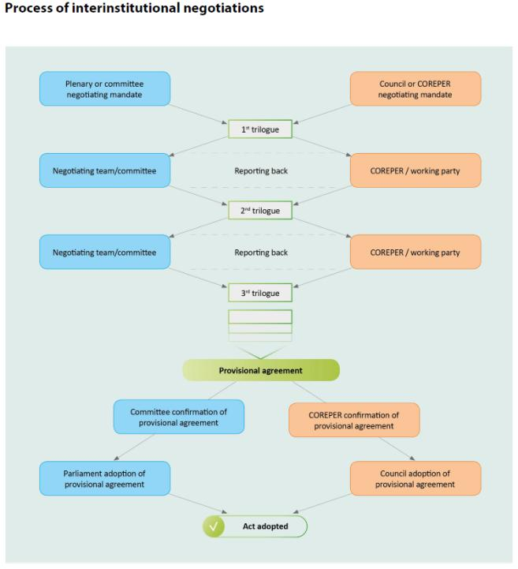

Slide 35
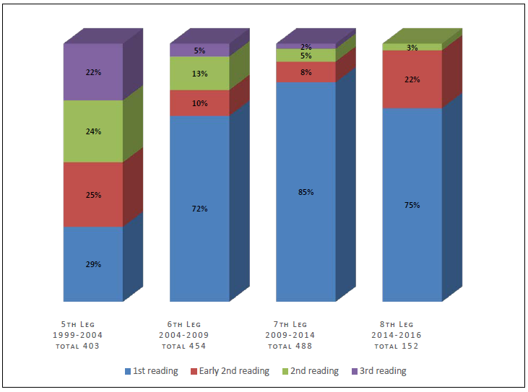
Levels of successful conclusion of legislative proceedings in the various stages (readings)

Slide 36
Legislative function of the Executive
What is the scope of the “executive” power in the European Union?
In many national constitutions the executive branch has a residual character: anything that is neither legislative nor judicial is considered to fall within its scope. This negative definition of the executive function has historical reasons: the original purpose of the separation-of-powers principle was to remove powers from an almighty authority (usually a monarch) to a parliament and the judiciary.
This negative definition has caused attempts to identify “prerogatives” of executive power. The most obvious lies within the field of external relations, which calls for strong executive authority and decision making. Another acknowledges the executive as – naturally – entrusted with the task of executing laws, and thus with the aim of maintaining internal peace within the country. This task of law enforcement is complemented by another – seemingly contradictory – task, also identified as an executive’s prerogative: the executive has the power to ‘govern’, that is to lead and direct the political community, being considered as the “centre of impulse and decision”. Thus the executive is considered to enjoy the power of decision, this power entailing the reactive task to enforce laws and the active task to propose laws.
This power of decision is typically contrasted with the power to adopt legislation. The latter lies traditionally with the Parliament. However, in the current demanding conditions of formulating and implementing public policies, the parliaments have been considered not to have the expertise nor the time to understand the details and implications of the policies enacted by them into law, thus necessitating a “secondary” legislator that would focus exactly on these aspects.
This has been named (Schutze) as one of the most important transformations of constitutionalism: the ‘legislative State’ of the19th (dominated by the Parliament’s rule-setting authority and action) found its limits in the normative needs of the ‘administrative State’ of the 20th century (in which the executive gained the power to adopt – delegated- legislation).

Slide 37
In the EU context, the Executive’s authority to set rules has been gradually formulated, based on the needs as well as the desires of the various institutions, within the limits set by the relevant case law of the ECJ.
The delegation of tasks by a principal (in the case of the EU the Parliament) to an agent (in the case of the EU the Commission) has to solve two problems: i) the definition of the objective that the agent should achieve on behalf of the principal (and/or ii) the definition of the process through which the agent should achieve whatever objective is set by the principal. This is because by defining the process, in addition to the objective, the principal deprives the agent from the excuse that the principal has set an objective that cannot be realistically achieved. This is especially true when the objective is dependent on the process. The solution to these two problems frames the scope of action of the agent.
Such empowerment of the Commission may be necessary in case technical updates are needed, substances or products need to be authorised or forbidden, or when uniform application is needed in the Member States. Where these decisions require speed, flexibility and / or further technical work, the ordinary legislative procedure could be a too heavy procedure. Such decisions, despite having a detailed and technical nature, can be politically important and can have significant impacts on health, the environment and the economy and can directly impact citizens, enterprises and complete economic sectors.
The question on delegation of legislative authority in the EU, has been enriched by a further particular, a characteristic which is known as “Comitology”. Comitology is defined as EU procedure in which a committee assists the European Commission in implementation of its tasks. The committees are forums for discussion, they consist of representatives from Member States and are chaired by the Commission. The Commission ensures that they reflect as far as possible the situation in each of the countries concerned. They enable the Commission to establish a dialogue with national administrations before adopting detailed implementing measures, by providing opinions on the Commission's proposed measures. These opinions can be more or less binding on the Commission, depending on the particular procedure specified in the legal act being implemented.
This scheme was employed for the first time in 1961 to deal with the implementation of several aspects of the Common Agricutural Policy; It was gradually spread across and beyond the field of agriculture; Its legitimacy was confirmed by the Court of Justice in 1972 (Köster);

Slide 38
Three types of committees: Advisory committees: provide their opinions to the Commission, which must try to take account of them; Management committees: they intervene when implementing measures relate to the management of programmes and when they have budgetary implications; Regulatory committees: they intervene in cases of implementing measures relevant to legislation applicable in the whole of the EU.
The Single European Act clarified the legal regime and there were three comitology decisions;

Slide 39
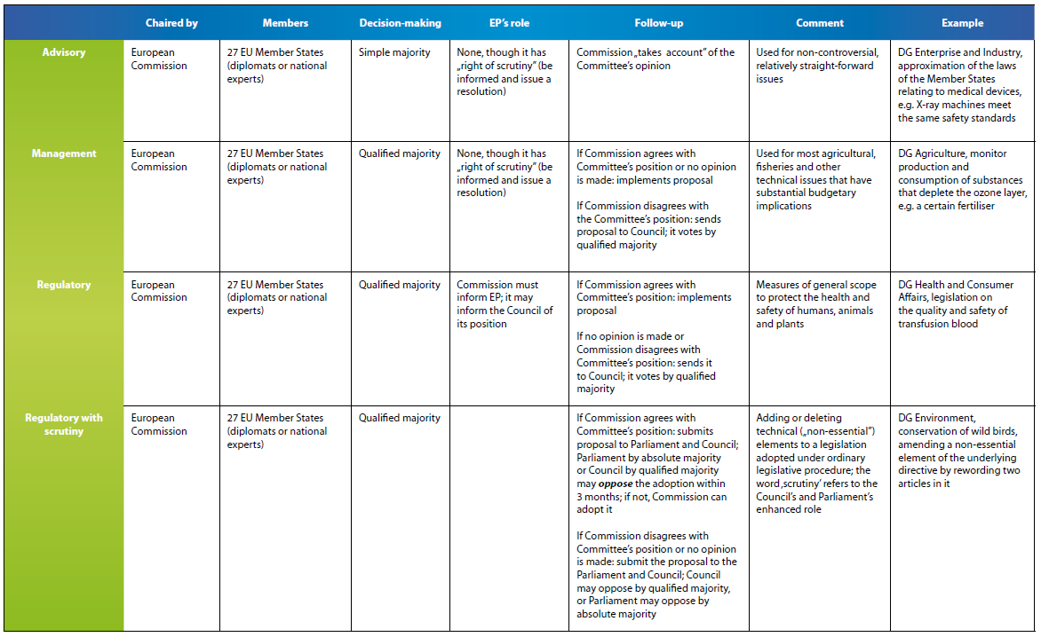
Comitology before the Lisbon Treaty

Slide 40
An interesting and contested point was the Regulatory Procedure with Scrutiny.
The European Parliament considered this procedure as “a defunct comitology procedure”.
It was used between 2006 and 2009 for “quasi-legislative” measures.
It exists in more than 300 existing legal acts and will temporarily continue to apply in these acts until they are formally amended.
This procedure empowers the European Parliament and EU Council to block a measure proposed by the Commission if it:
exceeds the Commission’s implementing powers,
is not compatible with the aim or content of the legal act, or
exceeds the EU’s powers or remit
This procedure was used extensively in the environment field.

Slide 43
Comitology after the Lisbon Treaty

Slide 44
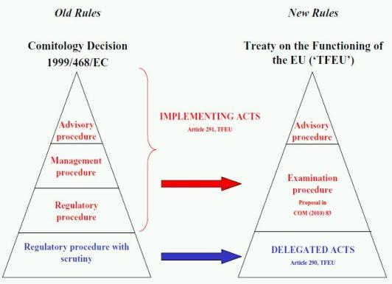
The 'delegated act' procedure (based on Article 290, TFEU) allows the Commission to adopt 'non-legislative acts of general application to supplement or amend certain non-essential elements' of a legislative act. The original legislative act must expressly grant this 'quasilegislative' power to the Commission. The objective of this procedure appears to be to allow the Commission, exercising its discretion and judgment, to adopt measures to achieve administrative efficiencies. The procedure is likely to be used (but not exclusively) in circumstances where the current regulatory procedure with scrutiny applies.
The 'implementing act' procedure (based on Article 291, TFEU) allows the Commission to implement 'legally binding Union acts'. In doing so, the Commission exercises an 'executive' power. The objective of this procedure appears to be to provide the Commission with the power to act to achieve uniform implementation of an act. The procedure is likely to be used in circumstances where the current advisory, management, and regulatory procedures apply.

Slide 49
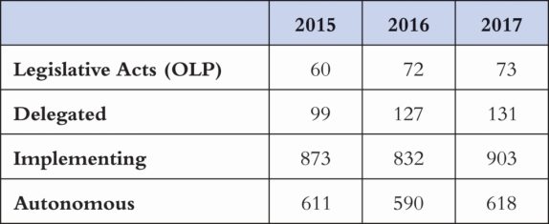
Most EU legislation has provisions enabling the Commission to adopt delegated or implementing acts. It is estimated that around 93% of EU laws adopted each year are delegated legislation.
There have been differing interpretations of the provisions regarding delegated legislation. The Parliament itself considers the provision of Art. 290 TFEU (delegated acts) as reinforcing its prerogatives as its veto power is unrestricted, and it can at any moment revoke the power of the Commission to adopt delegated acts under a given basic act. On the contrary, with regard to the provision of Art. 291 TFEU, the Parliament is more skeptical as its power is limited and there is no possibility to veto. Therefore, including in the basic act a provision granting the Commission delegated or implementing powers, as well as the choice between these powers, is very important and defines the role of the Parliament as primary legislator.

Slide 50
The entire issue of delegating such authority to the Commission has been criticized.
Wessels, although acknowledging the inevitability of comitology due to the increased scientific knowledge required for reaching expert decisions, argues that this a stape towards the realization of the “European administrative state”, encompassing closed groups of experts, who, using their sophisticated terminology and knowledge, will be in a position to convert, behind closed doors, political problems into administrative problems, thus operating at the espense of the EU’s political actors, namely the governments of the Members States and the EU institutions.
Harlow, adopting a more offensive approach, questions the democratic legitimacy of such proceedings, like comitology, by considering that the entire decision-making and – at the end – policy making process in the EU is beign handed out to an “industy of groups of experts” who are are not accountable to anyone.
Dehousse considers comitology as a natural result of the EU’s peculiar legal nature and regime, which entails two centres of governance (the Commission and the Council), and, in essence, employing experts in decision-making procedures, through comitology, is equivalent to granting a “blank cheque” to them to decide, something that is quite problematic given the lack of confidence towards experts, despite their expertise.
Finally, Weiler considers that despite the Commission’s and the Council’s views that they control the comitology procedures, these committees have been separated by them and they have acquired, clearly, the capacity and the possibility of making “political choices”, without any reference to the political institutions of the EU, and, even more, without any obligation for accountability on their behalf.

Slide 51
Examples of the procedure

Slide 52
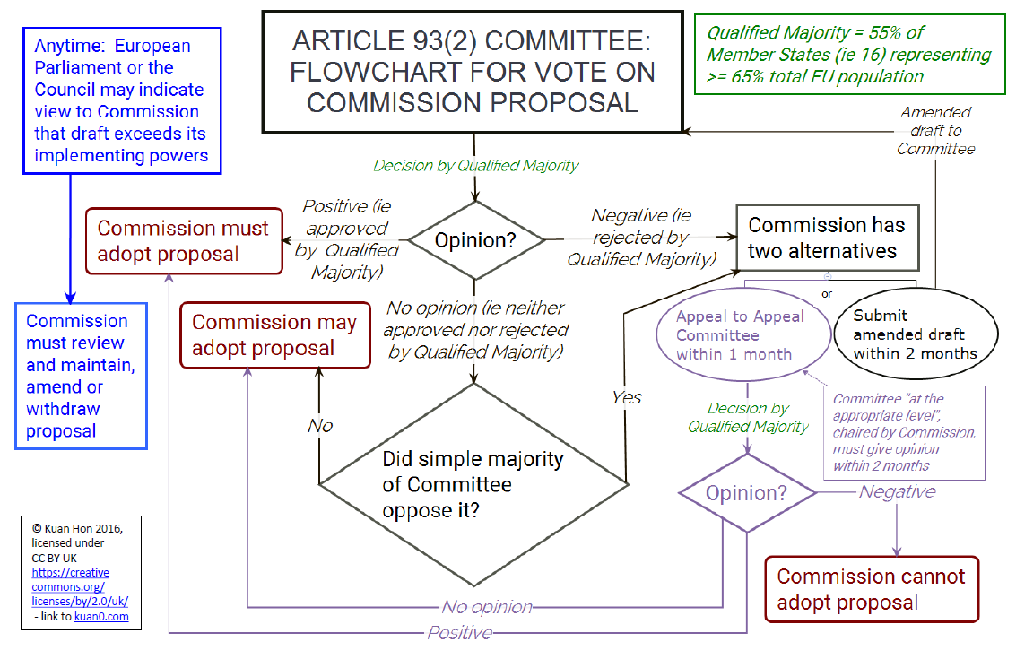
Under the General Data Protection Regulation (Regulation (EU) 2016/679), the European Commission has the power to make decisions in certain areas by way of "implementing acts", subject to approval of the relevant act by a committee under Art. 93(2) of the GDPR.

Slide 53
The current solution
The result of all this skepticism was the 2016 Interinstitutional Agreement on Better Law-Making (it replaced another similar Agreement of 2003), which aims on institutionalizing good practices in order to pursue better law-making, based on the importance of the Community method and the general principles of Union law, such as democratic legitimacy, subsidiarity, proportionality and legal certainty. It promotes transparency and stresses that Union legislation should allow citizens, administrations and businesses to easily understand their rights and obligations, avoid overregulation and administrative burdens and be practical to implement.
The Agreement entails the following:
Multiannual and annual programming: The Parliament, the Council and the Commission engage together in annual and multiannual legislative programming, thus implementing Article 17 of the Treaty on European Union. The three institutions draw up joint conclusions on the principal policy objectives and priorities at the beginning of a new legislative term and a joint declaration on annual interinstitutional programming, identifying files which should receive priority treatment, without prejudice to the co-legislators’ powers under the Treaties.

Slide 54
Better Law-Making Tools: The agreement recognises the positive contribution of impact assessments in helping the three institutions reach well-informed decisions, while stating that these assessments should not be a substitute for political decisions and should not lead to undue delays or prevent the co-legislators from tabling amendments. The Commission has to carry out impact assessments of all its legislative and non-legislative initiatives, delegated acts and implementing measures which are expected to have significant economic, environmental or social impacts. These impact assessments need to meet several requirements laid down in the agreement. Initiatives included in the Commission Work Programme or in the joint declaration must, as a general rule, be accompanied by an impact assessment. Parliament and Council must perform impact assessments on their own substantial amendments, where they consider this appropriate and necessary. In addition the agreement aims at improving public and stakeholder consultation, encouraging in particular the participation of SMEs and at improving the ex-post evaluation of existing legislation.
The choice of legal basis: The agreement implies that if a change to the legal basis is envisaged from the ordinary legislative procedure to a special legislative or a non-legislative procedure, the three institutions must exchange views thereon. It is stressed that the Commission must continue to fully play its role to ensure that the Treaties and the case-law of the Court of Justice are respected.

Slide 55
Delegated and implementing acts: In order to address the recurrent problems in the interinstitutional negotiations with regard to the choice between delegated and implementing acts, the Common Understanding on Delegated Acts was revised and attached to the agreement, inter alia addressing Council’s concerns with regard to the way Member States experts are consulted. According to Council this would facilitate future negotiations on that choice. The revised Common Understanding clarifies how this consultation should take place, while at the same time ensuring equal access to all information for the Parliament and Council. It also ensures access by Parliament and Council experts to the Commission expert groups on delegated acts. In addition the agreement confirms the need to enter into negotiations on non-binding delineation criteria and the need for the alignment of all existing legislation to the legal framework introduced by the Lisbon Treaty. In order to enhance transparency and enhance traceability of all the different stages in the lifecycle of a delegated act, a joint functional register of delegated acts was established.
Transparency and coordination of the legislative process: The agreement stresses that the Parliament and Council, as the co-legislators, are to exercise their powers on an equal footing and that the Commission must carry out its role as facilitator by treating Parliament and Council equally, in full respect of the roles assigned by the Treaties. The agreement aims at ensuring that the institutions keep each other informed throughout the procedure, better coordinating timetables and where appropriate accelerating the legislative process, while ensuring that the prerogatives of the co-legislators are respected. Communication during the whole legislative cycle should be improved and agreements reached should be announced jointly, for example through joint press conferences. In order to facilitate transparency a dedicated joint database on the state of play of legislative files was developed.

Slide 56
International agreements: a 'rendezvous clause' is agreed, committing the institutions to start negotiations on improved practical arrangements for cooperation and information-sharing regarding the negotiation and conclusion of international agreements, thereby inter alia addressing the implementation of Article 218(10) TFEU on Parliament’s right to be immediately and fully informed at all stages of the procedure.
Implementation and application of Union legislation: The agreement calls upon Member States (who as such are not a party to the agreement) to communicate clearly to the public measures that transpose or implement Union legislation. When Member States choose to add elements that are in no way related to the Union legislation that they are transposing, they should identify these additions in the transposing act or in an associated document. In its annual report to the Parliament and Council on the application of Union legislation, the Commission include reference to these additions, where relevant.
Simplification: The agreement commits to using recasting more frequently, to promoting harmonisation and mutual recognition, to cooperating in order to update and simplify legislation and to avoid overregulation and administrative burdens for citizens, administrations and businesses, including SMEs, while ensuring that the objectives of the legislation are met. In addition to its existing Regulatory fitness and performance programme (REFIT), the Commission must present an annual burden survey of the results of the Union’s simplification efforts. The Commission, wherever possible, quantifies the regulatory burden reduction or savings potential of individual proposals or legal acts and must also assess the feasibility of establishing, in REFIT, objectives for the reduction of burdens in specific sectors.
Implementation and monitoring of the agreement: The agreement commits the three institutions to ensure that they have the means and resources required for the implementation of the agreement. They must monitor that implementation jointly and regularly, at both the political level through annual discussions and at technical level in the Interinstitutional Coordination Group.

Slide 57
EU BUDGETING
The finances of the EU have been historically the field of clashes between all the EU actors concerned (Institutions, Member States, Civil society, Business, individuals, etc).
This should not come as a surprise.
The effort of all interested parties to exercise as much authority and/or influence as possible over the EU Budget’s enactment and implementation is quite reasonable, taking into account the content of such authority. This authority entails the following rights:
The right to create and collect revenue
The right to authorize and pay expenditure
The right to approve the budget as a whole
The right to audit the budget’s implementation
Given these rights, it is logical to conclude that the EU Budget is a complete expression, in both political and economic terms, of the Union’s ideological content, function as a point of testing the institutional balance of the EU, taking into account the levels of political sensitivity and of conflicts of interests which can be noted during the budgetary process.

Slide 58
Source:
C. Santiso Understanding the Politics of the Budget, Technical Report, January 2007, Inter-American Development Bank

Slide 59
Source:
C. Santiso Understanding the Politics of the Budget, Technical Report, January 2007, Inter-American Development Bank

Slide 60
The EU budgetary system can be distinguished into two aspects: its multiannual aspect and its annual aspect.
The first entails the Multiannual Financial Framework of the EU and the second the yearly EU Budget.
The yearly budget must be congruent with the Multiannual Framework.
As demonstrated below there is a distinct difference between the procedures of adoption of the Multiannual Financial Framework and the yearly EU Budget.
The starting point is the creation of revenue to finance the budget. As mentioned before, there four types of the EU own resources:
EU traditional own resources: customs duties and sugar levies
VAT own resource: This accrues from the application of a uniform call rate (for the period 2014-2020 this is 0.30% for all Member States except Germany, the Netherlands and Sweden that benefit from a reduced call rate of 0.15%) to the national VAT base, determined in accordance with rules that are common to all Member States.
Gross National Income (GNI)-based resource: This accrues from the application of a GNI call rate which is determined by the additional revenue needed to finance the budgeted expenditure not covered by the other resources. Thus a call rate is applied to the GNI of each of the Member States. Due to this covering mechanism the rate to be applied to the Member States’ gross national income varies from one financial year to another.
Other resources: taxation of EU officials, fines from the violation of EU Law, etc.

Slide 61
According to Art 311 TFEU, there is a special legislative procedure entailing a unanimous decision of the Council, after consulting the European Parliament, laying down the provisions relating to the system of own resources of the Union and possible establishing new categories of own resources or abolishing an existing category.
This decision shall not enter into force until its approval by the Member States.
The Council’s decision may provide for the adoption of implementing measures for the Union's own resources system. These will be enacted by Council Regulations, with a special legislative procedure, entailing the previous consent of the European Parliament.

Slide 62
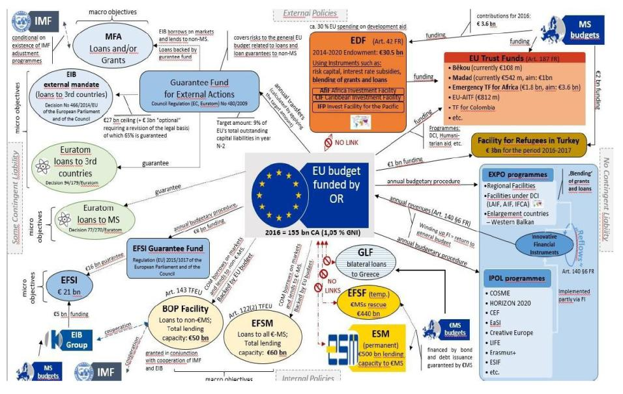
The EU budget is required to finance a very extensive variety of policies and activities

Slide 63
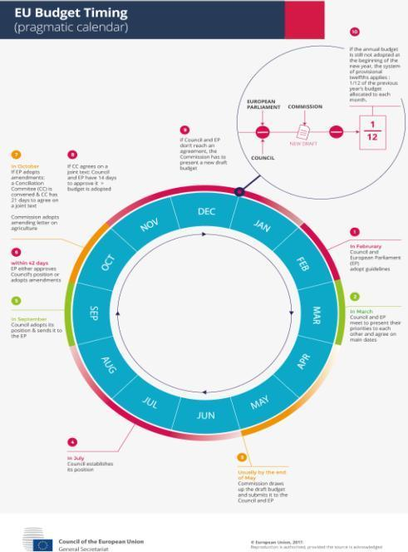
The enactment of the yearly EU Budget

Slide 65
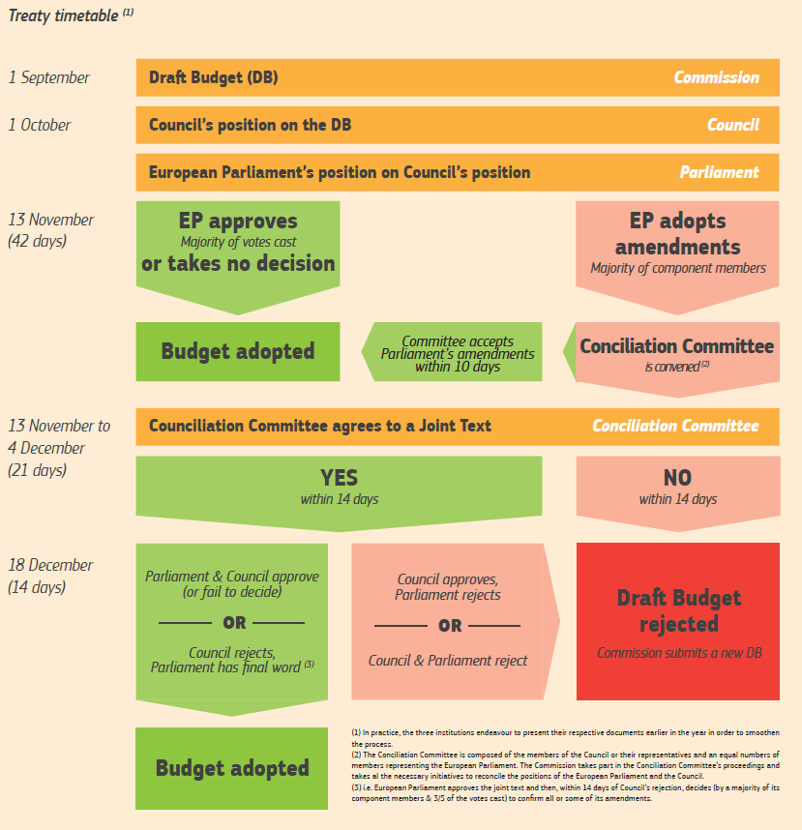
(1) In practice, the three institutions try to present their respective documents earlier in the year in order to smoothen the process.
(2) The Conciliation Committee is composed of the members of the Council or their representatives and an equal numbers of members representing the European Parliament. The Commission takes part in the proceedings and takes all the necessary initiatives to reconcile the positions of the Parliament and the Council.
(3) i.e. European Parliament approves the joint text and then, within 14 days of Council’s rejection, decides (by a majority of its component members & 3/5 of the votes cast) to confirm all or some of its amendments.
Note: no distinction between compulsory and non compulsory expenditure.

Slide 66
EU Budget Implementation
The European Commission is responsible for the EU Budget implementation in cooperation with the Member States, under the political control of the European Parliament
The European Commission may implement and manage the EU Budget under each of the following schemes (types of management):
Direct Management: exercised by the Commission’s services or by executive organisations
Shared Management: exercised by both the Commission’s services and the competent national authorities of the Member State
Indirect Management: exercised through granting authority of the budget’s implementation to third parties (i.e. national authorities of third countries, international organizations, NGOs, etc)
In practice, almost 76% of the EU Budget is being managed under the “Shared Management” scheme (with the Member States being responsible for the distribution of funds and the management of expenditure), 22% is being managed under the “Direct Management Scheme” and the remaining 2% under the “Indirect Management Scheme”.

Slide 68
The annual discharge procedure allows the European Parliament and the Council to hold the Commission politically accountable for the implementation of the EU budget. The European Parliament decides, after a recommendation by the Council, on whether or not to provide its final approval, known as 'granting discharge', to the way the Commission implemented the EU budget in a given year. When granted, it leads to the formal closure of the accounts of the institution for a given year. If not granted, it is considered to be equivalent to a motion of censure against the Commission, which may lead to its resignation (i.e. 1999).
When deciding whether to grant, postpone or refuse the discharge, the Parliament takes into consideration the integrated financial and accountability reporting prepared by the Commission along with the European Court of Auditors' Annual Report on how the budget has been spent and any relevant Special Reports.
During the discharge procedure, relevant Commissioners reply to written questions from the Committee on Budgetary Control (CONT) of the European Parliament and appear in the committee for an exchange of views (‘Hearings’).
For the financial year N, the Commission and the European Court of Auditors publish their key reports in year N+1, allowing the Parliament to take the decision on discharge in the first half of year N+2. This decision is accompanied by the Parliament's views and its requests to the Commission.
The Commission reports on its follow-up on the requests made by the Parliament and the Council during the discharge procedure.

Slide 69
Why have a Multiannual Financial Framework?
The MFF is substantively connected with the concept of budgetary discipline (see also Article 310 TFEU).
A multiannual framework for the Union’s financial operations was introduced as a means of financial management, after the 1988 reform, and it was designed to produce harmonious and controlled growth in the broad sectors of budget expenditure. At the same time, a new balance in the allocation of expenditure by means of guarantees for the development of policies was established, in particular the structural policies.
Thus, a reference framework was set, within which the various institutions would have to manoeuvre during each of the annual budgetary procedures. This reduced the risk of clashes between legislative power and budgetary power, by requiring overall consistency between the budgetary implications of legislative decisions and the financial framework laid down.
The Lisbon Treaty introduced a provision on the MFF, in EU primary law, with the following main characteristics (Art. 312 TFEU):
(1) The planning mechanism is adopted on the Commission’s initiative by the two arms of the budgetary authority in accordance with the procedure involving unanimous adoption by the Council following the consent of the European Parliament, the latter deciding by a majority of its component members.
(2) The duration of the financial planning mechanism at least coincides with (in practice exceeds) the term of office of the European Parliament and of the Commission;
(3) The planning mechanism includes a global resources ceiling and annual expenditure ceilings per heading and procedures are laid down to safeguard a margin of flexibility;
(4) It constitutes a binding framework for the annual budget.

Slide 70
All three institutions (Commission, Council, and Parliament) must facilitate the adopting procedure. This latter obligation is a very strong reminder of the spirit of the Interinstitutional Agreements that have established the multiannual financial frameworks so far.
The contents of the multiannual financial framework set the annual ceilings of all commitment appropriations and payment appropriations. The categories of expenditure must correspond to the Union’s major sectors of activity. This introduces(????) the budgetary Rule of Specification at multiannual programming level.
It is noteworthy, however, that there is little detail in the TFEU on what the EU resources in the MFF should be spent on: Only in para 3 of Article 312 TFEU it is stated that categories of expenditure shall correspond to the EU’s major sectors of activity which are then set out in other documents. This is the only indication, with regard the TFEU Financial Provisions, that there must be a policy agenda setting the aims to be achieved through the financing provided by the EU.
This is quite interesting as the Commission has noted that merely identifying the areas where the EU dimension and financial support can offer more is not in itself sufficient and that spending on the right policies is only worthwhile if it secures the desired results. According to the Commission, spending programmes must have a real impact, with the investment feeding through into action – action which is measured in terms of real impact, rather than in terms of the inputs involved. Not making any such substantive reference in the Financial Provisions of the TFEU is a striking choice, bordering to omission.

Slide 71
It is true that if forecasting for one year is difficult, multiyear estimates are even more complex, as they involve baselines, i.e. projections of future spending, assuming that existing policies will remain unchanged, with spending changing as a result of inflation and workload adjustments.
The relevant experience so far in the European Union context has provided with useful conclusions and successful attempts. Upgrading of this process at EU primary law level provided an institutional foundation for interinstitutional cooperation, despite the occasional “skirmishes” that have occurred between the three main institutions during such proceedings.
One noteworthy example is the notion of the Parliament’s “consent” before the Council’s legislative adoption of the relevant Regulation on the MFF. The Parliament’s view is that this “consent” means “approval”, thus making the overall procedure similar to the co-decision scheme of EU legislative action. The Commission’s and the Council’s view, however, is that if the EU states wanted such a procedure for the MFF would have adopted the corresponding provisions. The fact that in Art. 312 TFEU reference is made to “consent” and not “approval”, nor “co-decision”, nor “ordinary legislative procedure”, has given ground for disputing the Parliament’s view and advocating that the Parliament provides a broad political consensus on the Headings of the MFF and is not entitled to enter into details with regard to the MFF contents. In any case, the Parliament’s consent, in any form and meaning, is essential for the entire procedure to move on.

Slide 72
The 2021-2027 MFF Proposal
As it becomes obvious from the EU Law Primary Context, the challenges posed by the process of adopting an MFF are two-fold: procedural and substantive.
The procedural challenges refer to the various stages of action that needs to be taken by the institutions involved, as well as other stakeholders, both at decision-making level and at opinion-providing level.
And all these must take place within a time-frame that will not affect the proper functioning of the EU, despite the safeguard clause of para 4 of Art. 312 TFEU according to which, in case of delaying the adoption of the act relating to the MFF, the ceilings and other provisions corresponding to the last year of the previous MFF shall be extended until such time as that act is adopted.
The substantive challenges refer to the contents of the various headings (ie main spending categories) of the MFF both in terms of political substance and choices (ie the contents of the public policies to be pursued) as well as the amounts to be made available for the implementation of these policies (ie the maximum ceilings of funds for each policy).
On 2 May 2018, the Commission published its overarching legislative proposal for the next MFF. This was followed by sectoral proposals covering, among other things, the EU own resources and the main EU spending programmes. Overall, the MFF package comprises 51 legislative proposals, PLUS 4 other relevant to the MFF proposals.

Slide 73
Source: ECA, Remarks in Brief for the Commission’s proposal on MFF 2021-2027, 2019.

Slide 74
Source: ECA, Remarks in Brief for the Commission’s proposal on MFF 2021-2027, 2019.

Slide 75
Source: ECA, Remarks in Brief for the Commission’s proposal on MFF 2021-2027, 2019.

Slide 76
Source: ECA, Remarks in Brief for the Commission’s proposal on MFF 2021-2027, 2019.

Slide 77
Source: ECA, Remarks in Brief for the Commission’s proposal on MFF 2021-2027, 2019.

Slide 78
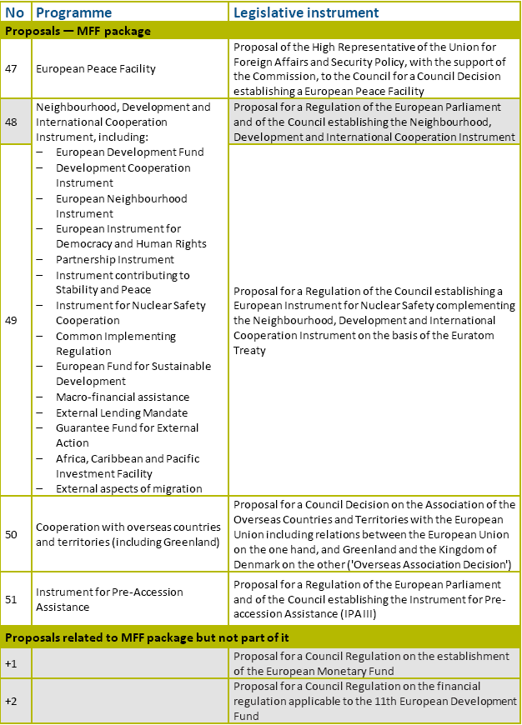
Source: ECA, Remarks in Brief for the Commission’s proposal on MFF 2021-2027, 2019.

Slide 79
Procedural Challenges
Given the above mentioned differences of approach on the Parliament’s scope of action in the MFF negotiation process, the various EU bodies and other stakeholders decided to put forward, at an early stage, in order to demonstrate their views, as well as the views of those represented by them, their understanding of the Commission’ proposals.
Thus, within 5 months (ie until October 2018) the European Economic and Social Committee, the European Committee of Regions, the European Court of Auditors, the Conference of Peripheral and Maritime Regions, and other stakeholders had expressed their views on the whole or parts of the Commission’s proposals.
The European Parliament itself presented its first views in May 2018 (before the publication of the Commission’s complete set of proposals).
The Council, during the Bulgarian (Jan-June 2018), Austrian (July-Dec 2018) and Romanian (Jan-June 2019) Presidencies, started the examination of the proposals, and prepared 20 partial general approaches or partial mandates.
The negotiations between the Council and the Parliament, taking into account the views put forward by other interested parties, have been initiated and so far there has been progress as there is a common understanding between the two institutions on 10 sectoral files, while 3 more were being discussed just before the EU parliamentary elections on the 26th of May 2019:

Slide 81
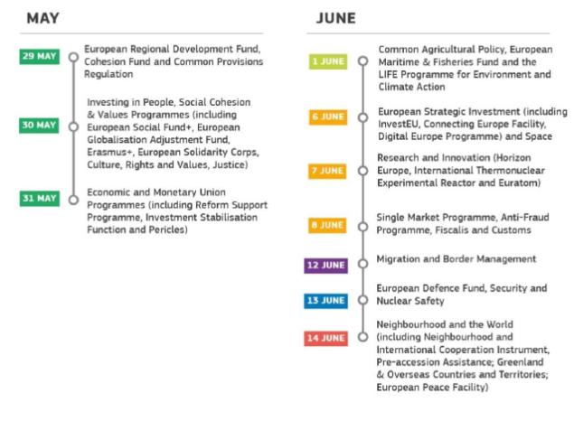
The real procedural challenge, however, has been the time-frame of the entire process. The reason for this: The EU parliamentary elections in May 2019.
The European Commission, taking into account the 2019 elections and being afraid of the possibility of the European Parliament’s composition to be significantly modified, thus creating new parameters on the political approach of the Parliament, pushed for a speedy adoption of the MFF.
At first, it presented the full set of its proposals at record time (at least for EU standards):

Slide 82
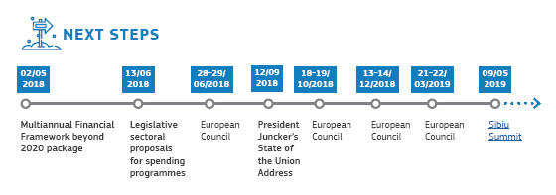
The initial time frame set by the Commission comprised a year-long process, as follows:
The overall concept of the Commission was to achieve the consent of the Parliament before the elections in May, in order to avoid possible conflicts with a new – possibly differentiated – composition of the Parliament, which would have other priorities with regard to the 2021-2027 MFF.
Despite the possible positive aspects of this approach, at least with regard to the continuity of the process, one could not avoid noting the obvious anxiety (bordering to possible disregard) on the results of the elections. If the EU is based on democracy (according to the Treaties), fear of the results of a procedure expressing directly the will of the electorate – regardless of how pleasant or unpleasant the content of this will might be – is not a tribute to the Union’s democratic legacy.
In any case, the aim of the Commission was not achieved & a new time-frame was set:

Slide 83
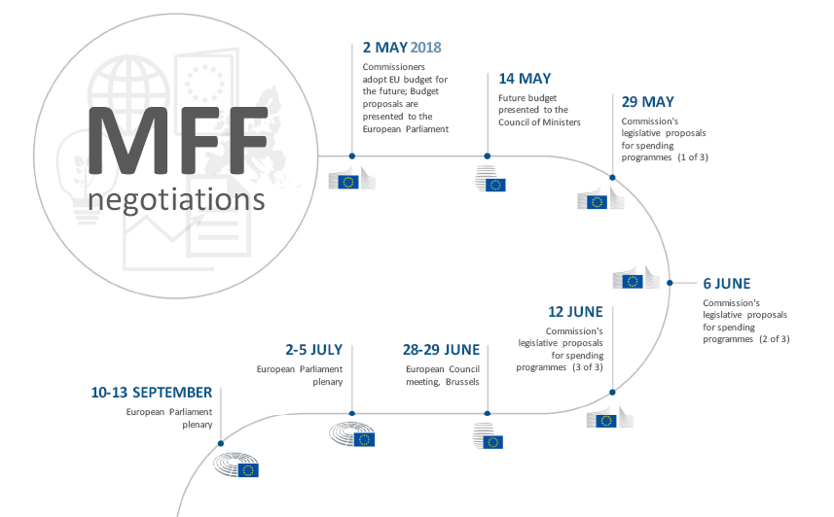
Source: ECA, Remarks in Brief for the Commission’s proposal on MFF 2021-2027, 2019.

Slide 84
It is expected that by that time also the new Commission will be appointed (November 2019) and the negotiating process will resume with a view to conclude all the aspects in time so by the end of 2020 all legislative instruments would be adopted and in force in time for the start of the 2021-2027 period.

Slide 85
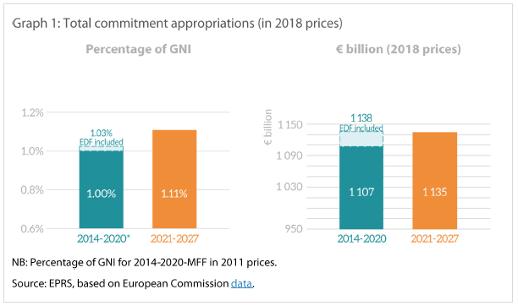
Substantive Challenges
The contents of the Commission’s proposals were very ambitious.
In terms of total amounts, and compared to the 2014-2020 MFF, they entailed:

Slide 89
Source: ECA, Remarks in Brief for the Commission’s proposal on MFF 2021-2027, 2019.

Slide 90
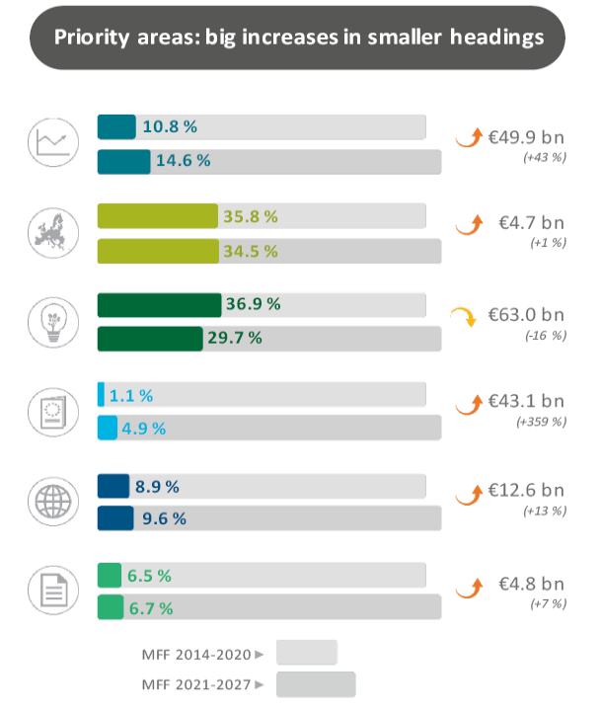
Source: ECA, Remarks in Brief for the Commission’s proposal on MFF 2021-2027, 2019.

Slide 91
Source: ECA, Remarks in Brief for the Commission’s proposal on MFF 2021-2027, 2019.

Slide 92
One of the first criticisms to the Commission’s proposal focused on the effort to “show” that more money was to included in the new MFF, compared to the 2014-2020 MFF (see above). A number of factors (such as inflation and the budgetary impact of the UK’s withdrawal from the EU) need to be taken into account when making any comparison with the 2014-2020 MFF
Another similar point of criticism was that the Commission used interchangeably current prices and ‘2018 prices’ (or constant prices) as points of reference for the amounts included in its proposal. This caused confusion as follows:
‘2018 prices’ (otherwise known as ‘constant prices’) correspond to the price index of a reference year - the year 2018 in this instance.
‘Current prices’ are the prices provided at a given moment (a day of a month of a specific year) and refer to prices in ‘real’ value, which means that they are adjusted over time to take into account inflation. In the case of the EU budget, the Commission applies a fixed ‘deflator’ of 2% each year on the basis of 2018 prices.
To compare the 2014-2020 and the 2021-2027 MFFs, it is unfair to compare the two reference periods in ‘current’ prices as they include price variations linked to inflation.
It is more suitable to compare both MFFs using the same reference year: e.g; 2018.

Slide 93
Source: European Parliamentary Research Service, Multiannual Financial Framework 2021-2027: Commission Proposal - Initial comparison with the current MFF, May 2018

Slide 94
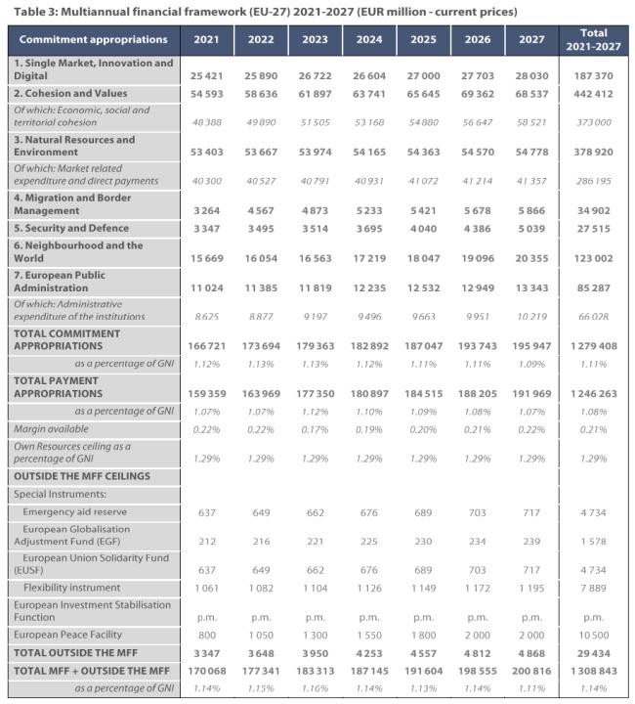
Source: European Parliamentary Research Service, Multiannual Financial Framework 2021-2027: Commission Proposal - Initial comparison with the current MFF, May 2018

Slide 95
Source: European Parliamentary Research Service, Multiannual Financial Framework 2021-2027: Commission Proposal - Initial comparison with the current MFF, May 2018

Slide 96
Source: European Parliamentary Research Service, Multiannual Financial Framework 2021-2027: Commission Proposal - Initial comparison with the current MFF, May 2018

Slide 97
Own Resources
For the next MFF the Commission proposes to retain customs duties as one of the EU’s own resources, but at a lower collection rate for Member States. It also proposes to retain the GNI-based resource as a significant source of revenue and simplify the calculation for contributions based on the VAT component. Together, these three own resources would make up 87 % of EU revenue. In addition, three new own resources would be introduced, based on a new tax scheme for EU companies, the EU Emissions Trading System (ETS) and a tax on unrecycled plastic packaging.
The proposed EU financing system remains complex. In addition, there are several issues which may undermine the effectiveness of the proposed new own resources. For example, the Commission proposes calculating the resource based on the EU ETS as a percentage of receipts from the auctioning of emissions allowances, the overall volume of which is fixed. While this would certainly generate revenue, it would not create an additional incentive for Member States to reduce greenhouse gas emissions. The common consolidated corporate tax base (CCCTB) would not be phased in until several years after the start of the new MFF. And finally, Member States would need to harmonise how they collect and calculate plastic recycling data, which would then have to be verified by the Commission.
The Commission may reconsider its proposal to simplify the VAT-based resource, as the assumptions it uses to calculate the new contributions do not match the steps in the reasoning behind the simplification (ie they do not focus on supplies which are subject to the VAT standard rate and are not based on the standard-rated receipts – thus the overall system maintains its main flaw: it still does not provide any direct link to the tax base, while such a link could be obtained by applying a call rate directly to the VAT receipts).
To offset the impact of the UK’s withdrawal from the EU and the inclusion of the European Development Fund (EDF) in the EU budget, the Commission proposes increasing the ceilings on own resources. It also proposes phasing out the correction mechanisms that currently apply to certain Member States. Doing this would lead to a more transparent and less complex system. However, the Commission does not propose to complete the process until 2026.

Slide 98
Cohesion
The Commission has put forward a proposal for a common provisions regulation (CPR) for seven EU funds under shared management: the European Regional Development Fund, the European Social Fund Plus, the Cohesion Fund, the European Maritime and Fisheries Fund, the Asylum and Migration Fund, the Internal Security Fund and the Border Management and Visa Instrument. Taken together, these funds are worth around €360 billion, approximately 30 % of the total budget for 2021-2027.
Funding conditions and performance orientation: The Commission aims to strengthen the link between the use of EU funding and the European semester, and the move from ex-ante conditions to simpler “enabling” conditions. However, in the absence of an EU-wide strategy or set of targets which would provide a clear vision of what the EU wishes to achieve through its policies, it will be up to the Member States to define strategic goals for the funds concerned. Care will be needed to ensure that these national/regional goals are sufficiently ambitious.
Simplification: The aim for simplification might have trade offs, at least as it is presented in the proposal, with regard to compliance and sound financial management. In particular:
— simplification may come at the cost of clarity for beneficiaries and national or regional administrations;
— the wide range of measures proposed (e.g. simplified cost options, financing not linked to costs) could mean reimbursements that are disproportionate to the costs incurred, which poses a value-for-money risk; and
— the suppression of certain features, such as ex-ante programme assessments, appraisals of major projects, strategic reporting and the performance reserve, would weaken the mechanisms in place to deliver results.
Accountability: The proposal shifts responsibility for implementation to the Member States, broaden the single audit arrangements and reduce the role of the Commission. If applied correctly, these changes certainly have the potential to reduce administrative costs and increase efficiency. However, they would also eliminate supervision, at the risk of greater levels of irregularities in spending, and could ultimately jeopardise the past 20 years’ progress in internal control.

Slide 99
Agriculture and Natural Resources
The Commission’s proposal for the post-2020 common agricultural policy (CAP), entails funding of around €330 billion. The key changes compared to the current MFF can be summarised as follows:
— one CAP strategic plan per Member State for all CAP expenditure (direct payments, rural development and market measures);
— efforts to move towards a performance-based system;
— a redefinition of eligible spending (based on reported outputs and a new concept of legality and regularity).
— changes in control systems, in particular for certification bodies.
Funding conditions and performance orientation
The shift to a performance-based model for the CAP is correct, however, the absence of clear, specific and quantified EU objectives creates uncertainty about how the Commission would assess Member States’ CAP strategic plans. The proposed performance framework provides only weak incentives: targets could be missed by a considerable margin with little impact on EU funding, and successful performance could trigger at best a marginal ‘performance bonus’.
Also the largest share of CAP spending continues to consist of direct payments to farmers but the proposal contains insufficient evidence that farmers really need this form of income support.

Slide 100
Accountability
The Commission’s assessment of eligibility would be based on outputs and an operational governance system, but would exclude rules contained in the CAP strategic plans in respect of individual beneficiaries. The proposal gives no definition of ‘output’, therefore, as for certain measures output depends upon beneficiaries’ compliance with commitments set out in the strategic plans, it is not clear how the eligibility of some expenditure would be assessed.
In addition, the proposal weakens the supervisory role of both Member States and the Commission in the following ways:
— as in the past, paying agencies would be tasked with ensuring the legality and regularity of operations financed by the CAP, while certification bodies would check the functioning of governance systems. However, it is unclear whether those checks would also cover definitions and any specific eligibility criteria in strategic plans. Moreover, it would no longer be mandatory for certification bodies to verify legality and regularity;
— the Commission, although ultimately responsible for implementing the budget, would no longer receive control statistics from paying agencies and would therefore be unable to quantify ineligible expenditure. The current practice of certification bodies giving assurance with regard to payments to individual farmers would also cease.

Slide 101
Neighbourhood, development and international cooperation
The Commission proposed the formation of the Neighbourhood, Development and International Cooperation Instrument (NDICI), by merging several existing external action instruments. €89.2 billion is proposed in funding to implement the NDICI for the 2021-2027 period.
Simplification and flexibility: The proposal clearly has the potential to simplify operations in this policy area. In particular, incorporating the EDF into the NDICI would bring it under the EU budget. The result would be more consistency between the various EU funds providing financial support, and stronger democratic oversight for the European Parliament. It remains to be seen whether the merging of funds would be enough on its own to allow more flexible responses to unforeseen challenges and crises.
Also increasing – as proposed – the thresholds above which action plans and measures must be adopted by means of implementing acts, could weaken the oversight arrangements.
Performance: The proposed performance-based approach should apply in all cases, not only to ‘Neighbourhood’ countries. Similarly, the use of results-based programming should also extend to thematic programmes.
It is necessary that the specific objectives of the NDICI should be more closely linked to key performance indicators.
Given that the EDF would be brought into the EU budget, the rules on budget support in the EDF financial regulation should also be aligned with those applicable to the EU’s general budget. In addition, the scope of the Commission’s discretionary power over budget support to overseas countries and territories (OCTs) has to be clarified.

Slide 102
Safeguarding the rule of law
The Commission proposed a draft regulation to protect the EU budget against ‘generalised deficiencies’ as regards the rule of law in Member States (such as insufficient independence of the judiciary or failure to prevent, correct and punish unlawful decision-making by public authorities).
The aim of this legislative proposal is welcome, in the view that such contingencies may affect the sound financial management or other financial interests of the Union. This new mechanism is more specific than other options available to the Commission in terms of scope, effectiveness and applicability.
However, the proposal in this stage lacks certain clear and specific criteria defining what would constitute a ‘generalised deficiency’ or how measures would be implemented. Hence, there is a need for additional clarification of the procedure and scope of the measures. Finally, it is necessary to include safeguards to avoid any adverse impact on beneficiaries of EU programmes.
An interesting point refers to the legal basis of the proposed regulation. The proposal was based on Art. 322 TFEU which provides for the use of the ordinary legislative procedure. Given that the proposal was included in the overall proposal of the Commission for the MFF 2021-2027, one could argue that the suitable legal basis is Art. 312 TFEU, which provides (as mentioned before) for a special legislative procedure entailing, inter allia, a unanimous Council decision. Given that some Member States, such as Poland and Hungary, have already expressed their disagreement on the proposed Regulation, using Art. 312 TFEU as its legal basis would lead to a dead-end. Thus the QMV decision making scheme included in the ordinary legislative procedure makes the adoption of this proposed Regulation quite possible, by overriding some Member States’ objections.

Slide 103
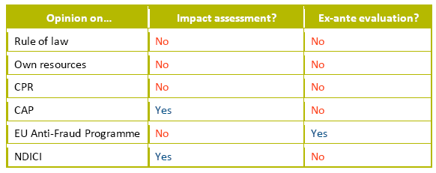
Assessing the impact of legislation: the “better regulation” principle
Impact assessments form a key part of the Union's “better regulation” agenda, which seeks to design and evaluate EU policies and laws so that they achieve their objectives in the most efficient and effective way. In particular, they examine whether there is a need for EU action and analyse the possible impacts of available solutions. Assessments are required whenever a Commission initiative, of any kind, is expected to have significant economic, social or environmental impacts. Assessments are therefore possible for legislative proposals, non-legislative initiatives (e.g. financial programmes, recommendations for the negotiation of international agreements) and implementing/delegated acts. The findings of the impact assessment process are summarised in a report. The Commission’s Regulatory Scrutiny Board checks the quality of each report and issues an opinion accordingly.
In accordance with the Financial Regulation, programmes and activities which entail significant spending are also subject to ex-ante evaluation. Where a programme or activity is expected to have significant economic, environmental or social impacts, this evaluation may take the form of an impact assessment — and in this case, the Commission will also need to examine a range of options for implementation.
The Commission had made limited comprehensive and documented impact assessments and ex-ante evaluations in areas concerned by the MFF package (see Table).

Slide 104
State of play of negotiations
Source: European Parliamentary Research Service, 2021-2027 Multiannual Financial Framework and New own Resources, Analysis of the Commission’s Proposal, July 2018

Slide 105
Source: European Parliamentary Research Service, 2021-2027 Multiannual Financial Framework and New own Resources, Analysis of the Commission’s Proposal, July 2018

Slide 106
Source: European Parliamentary Research Service, 2021-2027 Multiannual Financial Framework and New own Resources, Analysis of the Commission’s Proposal, July 2018

Slide 107
Source: European Parliamentary Research Service, 2021-2027 Multiannual Financial Framework and New own Resources, Analysis of the Commission’s Proposal, July 2018

Slide 108
And what will happen
if all these fail???
If no real consensus and no cooperation is achieved???
If the system fails to accommodate the interests and desires of all interested actors and stakeholders????
The outcome would be a chaotic clash of powers that will eventually result in the prevalence of the collapse of the European integration experiment, a development that may be personified by an ominous …figure…

Slide 109
THANK YOU FOR YOUR ATTENTION!!!

